Slide 1
Cinemunchies
Team Urkel
May 2018
Notes:
Kimberly

Slide 2
Contents
Team Urkel
What’s Been Missing
Description of project
Project structure
Project selection process
Our approach
Tools and technologies
Features and functions
Our challenges
Our successes
What we learned
Next Steps
Questions & answers

Slide 3

Team Urkel
Kalsang Bhutia
Robyn Craig
Zac Keilholz
Kimberly Maturo-Hilt

Slide 4

Mission & Value
Mission:
Design a collaborative space that links love of the cinema and the love of munchies together for an ahhhh, ohhhhh or WOW experience.
Value:
We aim to deliver creativity and ease to our solutions as well as our love and passion for food and movies to our customer experience.

Slide 5
What’s Been Missing
It’s simple, ever watch a movie?
Ever think to yourself, that what the actors are eating either looks good or sounds good.
Answered YES to both the above, then CINEMUNCHIES is what you need.
We bring the munchies of the movies to you.
Search a movie
See a list of munchies
Select the desired munchie
Get the recipe
Don’t see the munchie yet, then add to our ever expanding database!
Want to know what movie to pair with a munchie, we got you covered for that too! (future functionality)
Notes:
Robyn

Slide 6
Description of Project
It’s simple, ever watch a movie?
Ever think to yourself, that what the actors are eating either looks good or sounds good.
Answered YES to both the above, then CINEMUNCHIES is what you need.
We bring the munchies of the movies to you.
Search a movie
See a list of munchies
Select the desired munchie
Get the recipe
Don’t see the munchie yet, then add to our ever expanding database!
Want to know what movie to pair with a munchie, we got you covered for that too! (future functionality)
Notes:
Robyn

Slide 7
Project Team Structure
- Overall technical responsible
- Solution design advisory
- Firebase
Solution Architect & Back-end Development
- Jquery
-Javascript
- AJAX
-API calls
- Bootstrap
- Matrialize
- HTML
- CSS
- Visual design, imagery, graphics
Front End Development
- Overall project management
- Jira administrator
-UX testing and issue identification
- wireframing
Project Manager
UX Tester
Zac
Kalsang
Robyn
Kimberly
Front-end & Back-end Development
Notes:
Kalsang

Slide 8
Project Selection Process
ALL IDEAS
SeeFood
Find a Dog Park
Where to Meet
TOP IDEAS
Where to meet
SeeFood
FINAL IDEA
CineMunchies*
All team members submitted ideas
37 ideas in total
Each team member picked their Top-5
Each idea which received a rating was presented, discussed, challenged and brain-stormed the experience
Narrowed down top choices
Another team was already working on the Where to Meet
All agreed to move forward with SeeFood
New name established upon discussion and input from Jesse for project approval
Name provided by Jesse Mortenson
Notes:
Kalsang

Slide 9
Features and Functions
Product Demonstration:
https://zackeilholz.github.io/CineMunchies/
Notes:
Kimberly

Slide 10
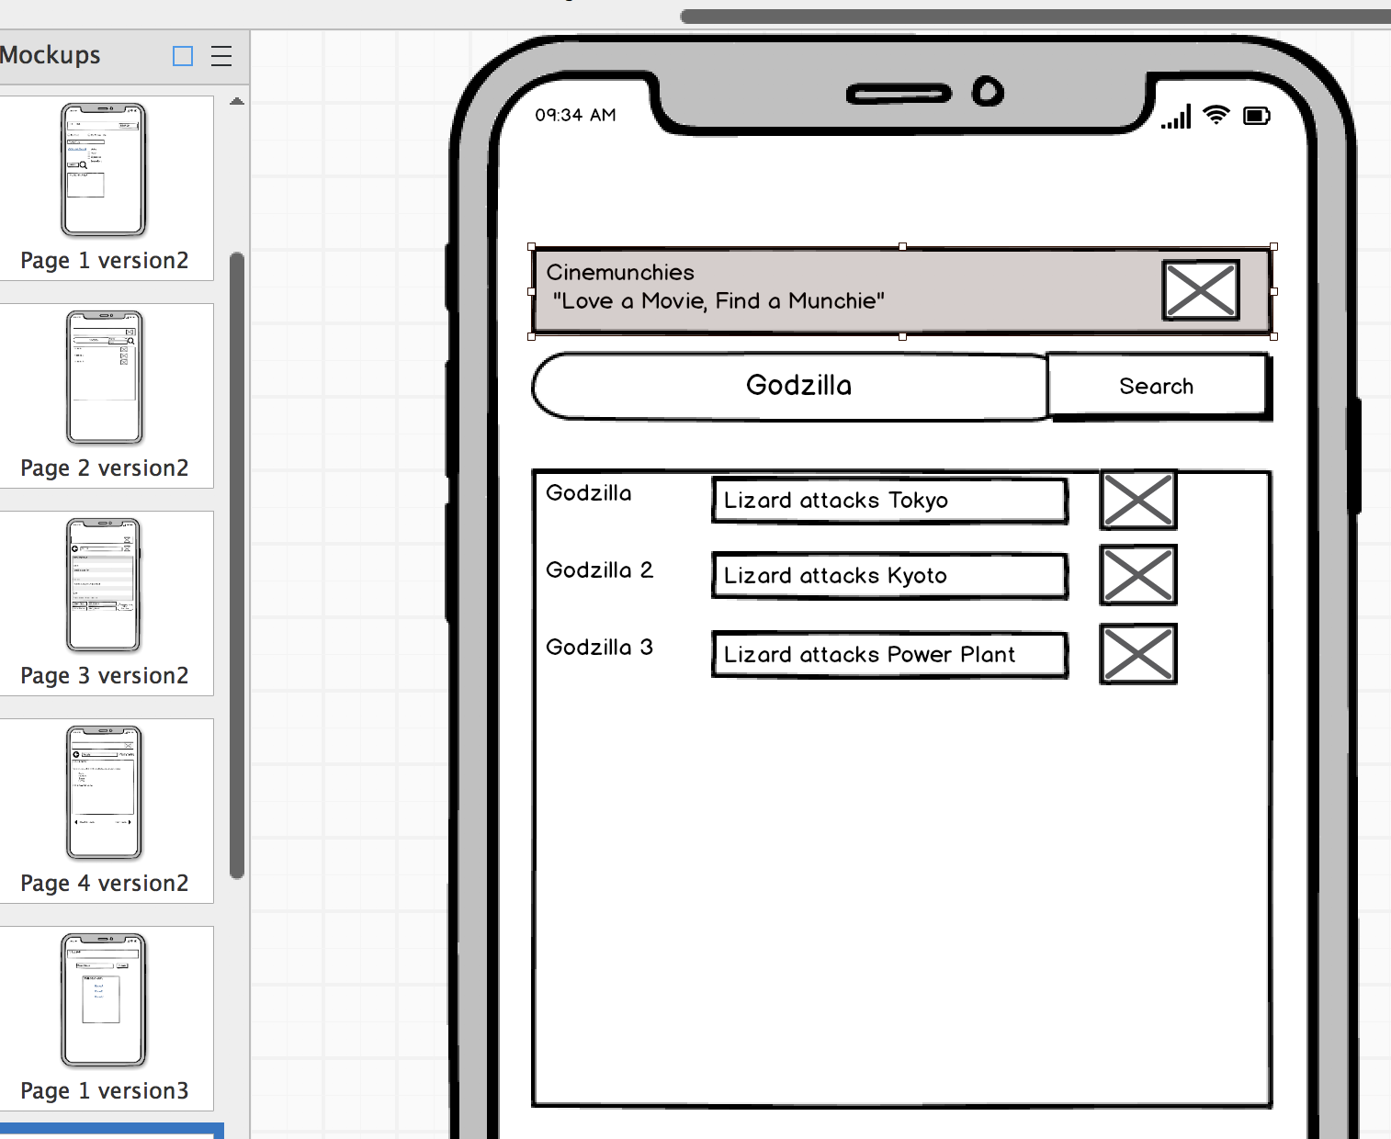
Tools and Technologies
Visual Studio
HTML / CSS coding
Jquery/JS/AJAX coding
CSS
BootStrap
Materialize
Multiple browser for testing
Chrome
Safari
FireFox
Multiple devices for testing responsiveness
PC
iPad
iPhone
Jira
Project management
Issue logging
Product Backlog
Balsalmiq
Wire Faming for a solution designs
Notes:
Kalsang

Slide 11
Our Approach
Brainstorming
Continuous idea sharing
Kanban
Creation tasks, bugs, stories
Agile
Broke down into 4 small sprints
Waterfall
Had definitive start and and end goals
Trail & Error
Communication
Assignment of work
Four Major Version Pushes
lots of minor version pushes
Had some iterate development and design work in a sprint and across sprints
Had definite roles
MVP
Clearly identify the MVP and focus on DELIVERING IT!
Create the product backlog
Notes:
Kalsang

Slide 12
Our Challenges
Branching & Merging
work with TA
communication
A single Page format
testing, testing, testing
clearly documenting the experience
trial and error
Creative Differences
Discuss
COMPROMISE
Notes:
Kalsang

Slide 13
Our Successes
Mobility
Functionality
Design
Team work
Positive attitudes
Willingness to listen
Adaptability
Helpfulness
Wanted a mobile solution; kept to the delivering a mobile friend solution
2 API calls
Firebase database
Clean
Crisp
Simple
Notes:
Zac

Slide 14
What We Learned
Accept CHANGE in Course
Test and then test again
Communicate, there is never enough talking
Prioritize the deliverable
Notes:
Consider talking about:
Constraints vs Objectives

Slide 15
Next Steps
Notes:
Zac

Slide 16
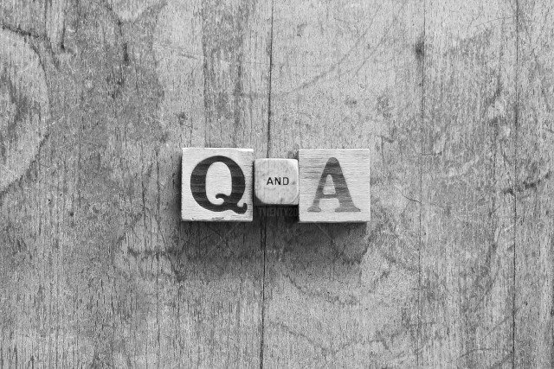
Questions & Answers

